Slide 1
Microsoft 365 Enterprise
Licensing overview
May 2021
Latest diagrams available here:
https://m365maps.com

Slide 2
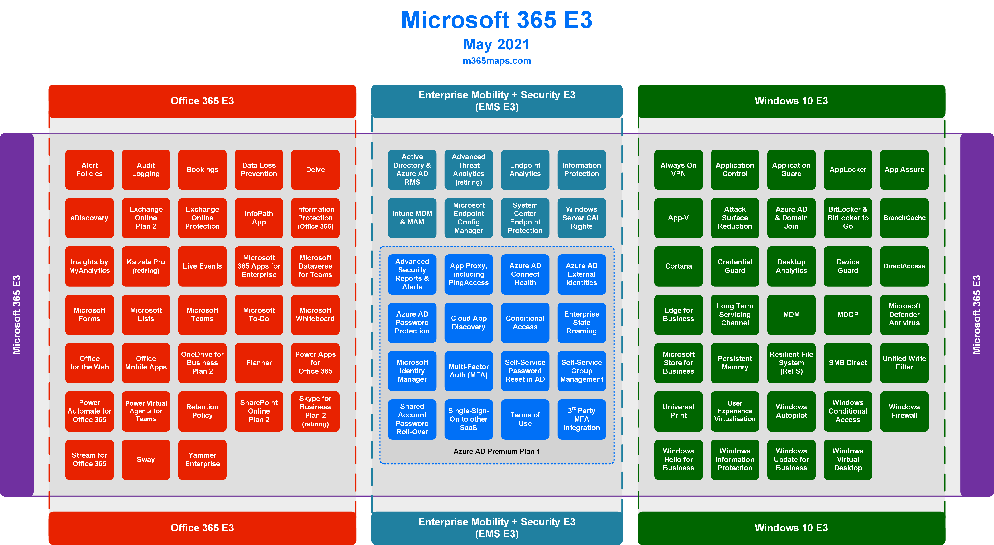

Slide 3
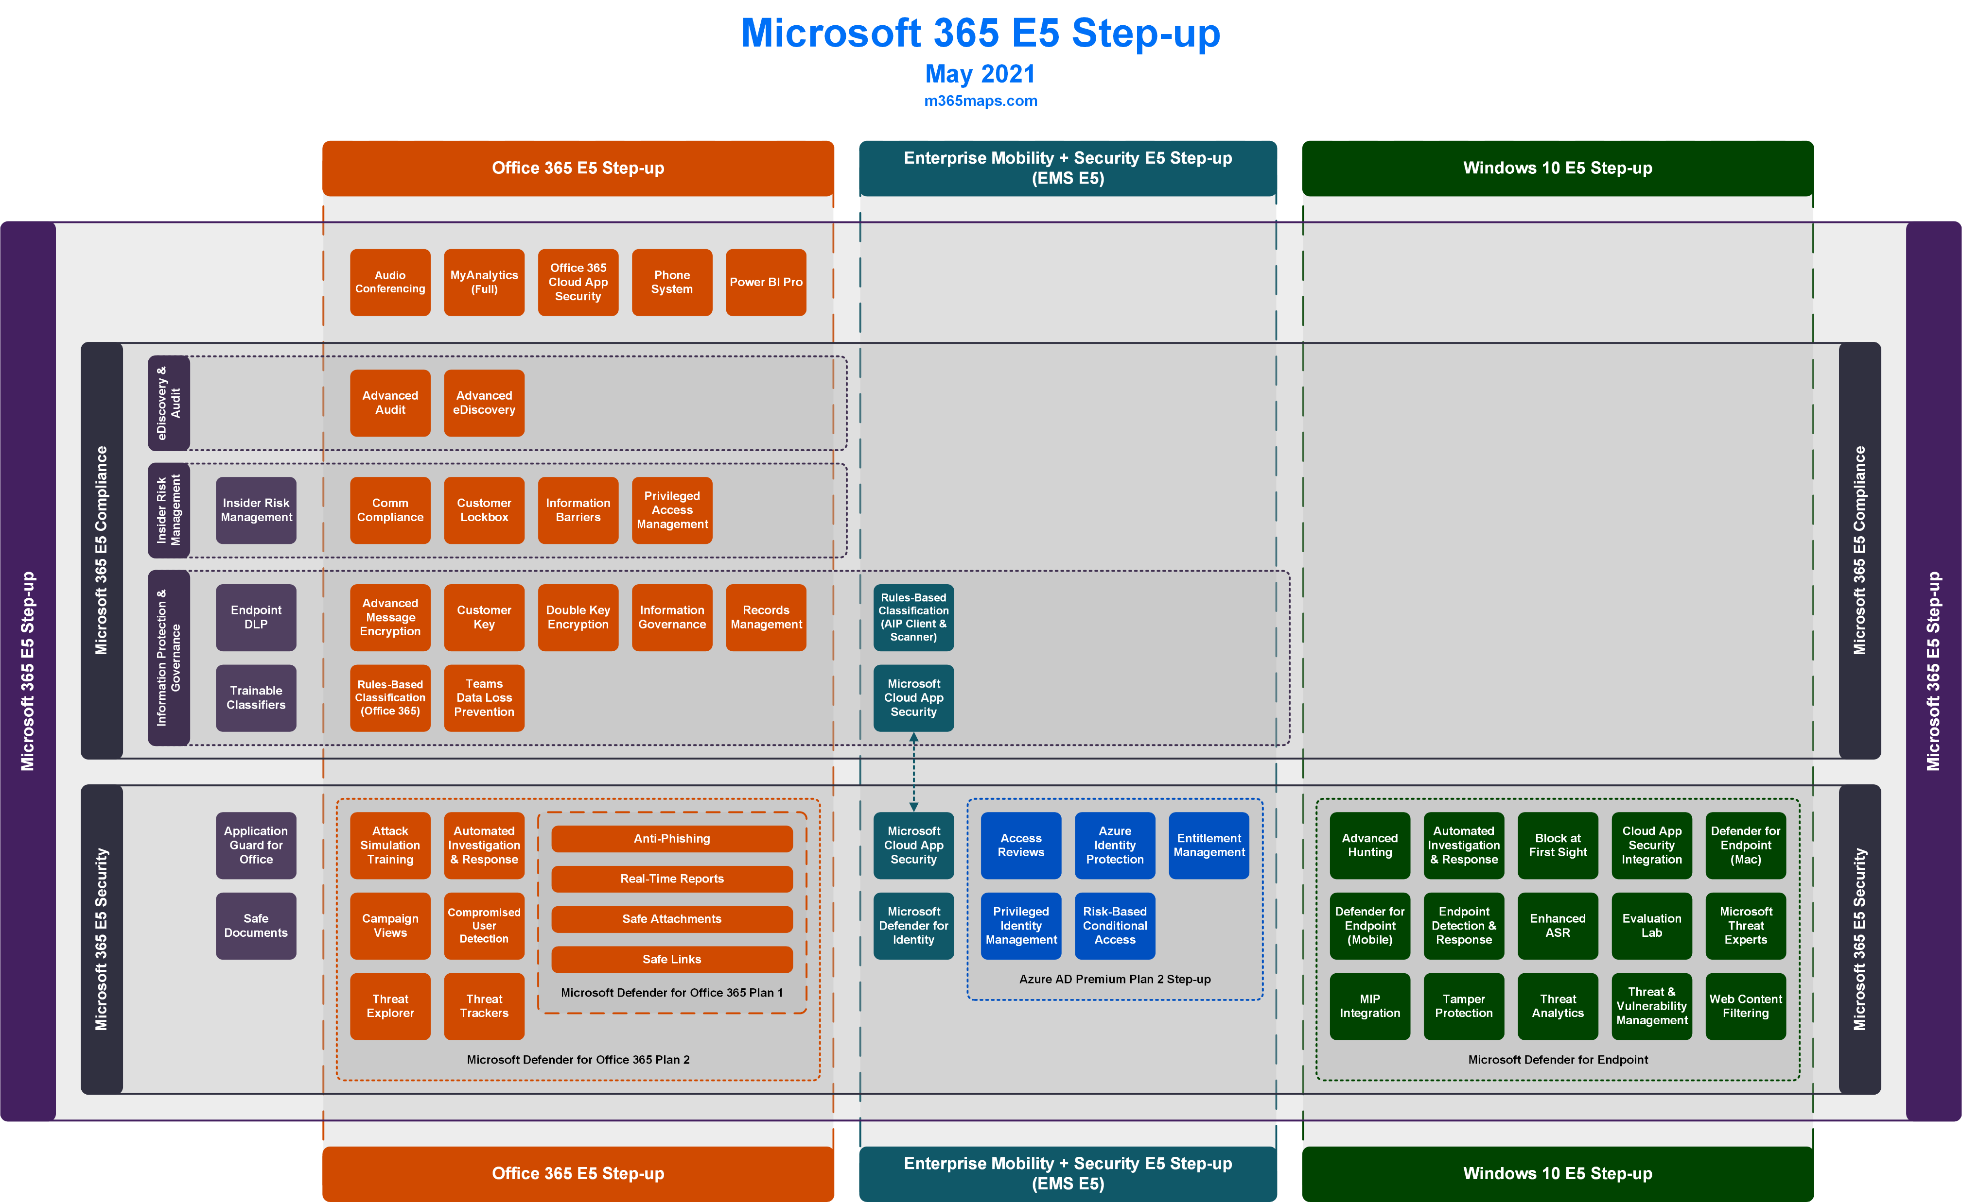

Slide 4
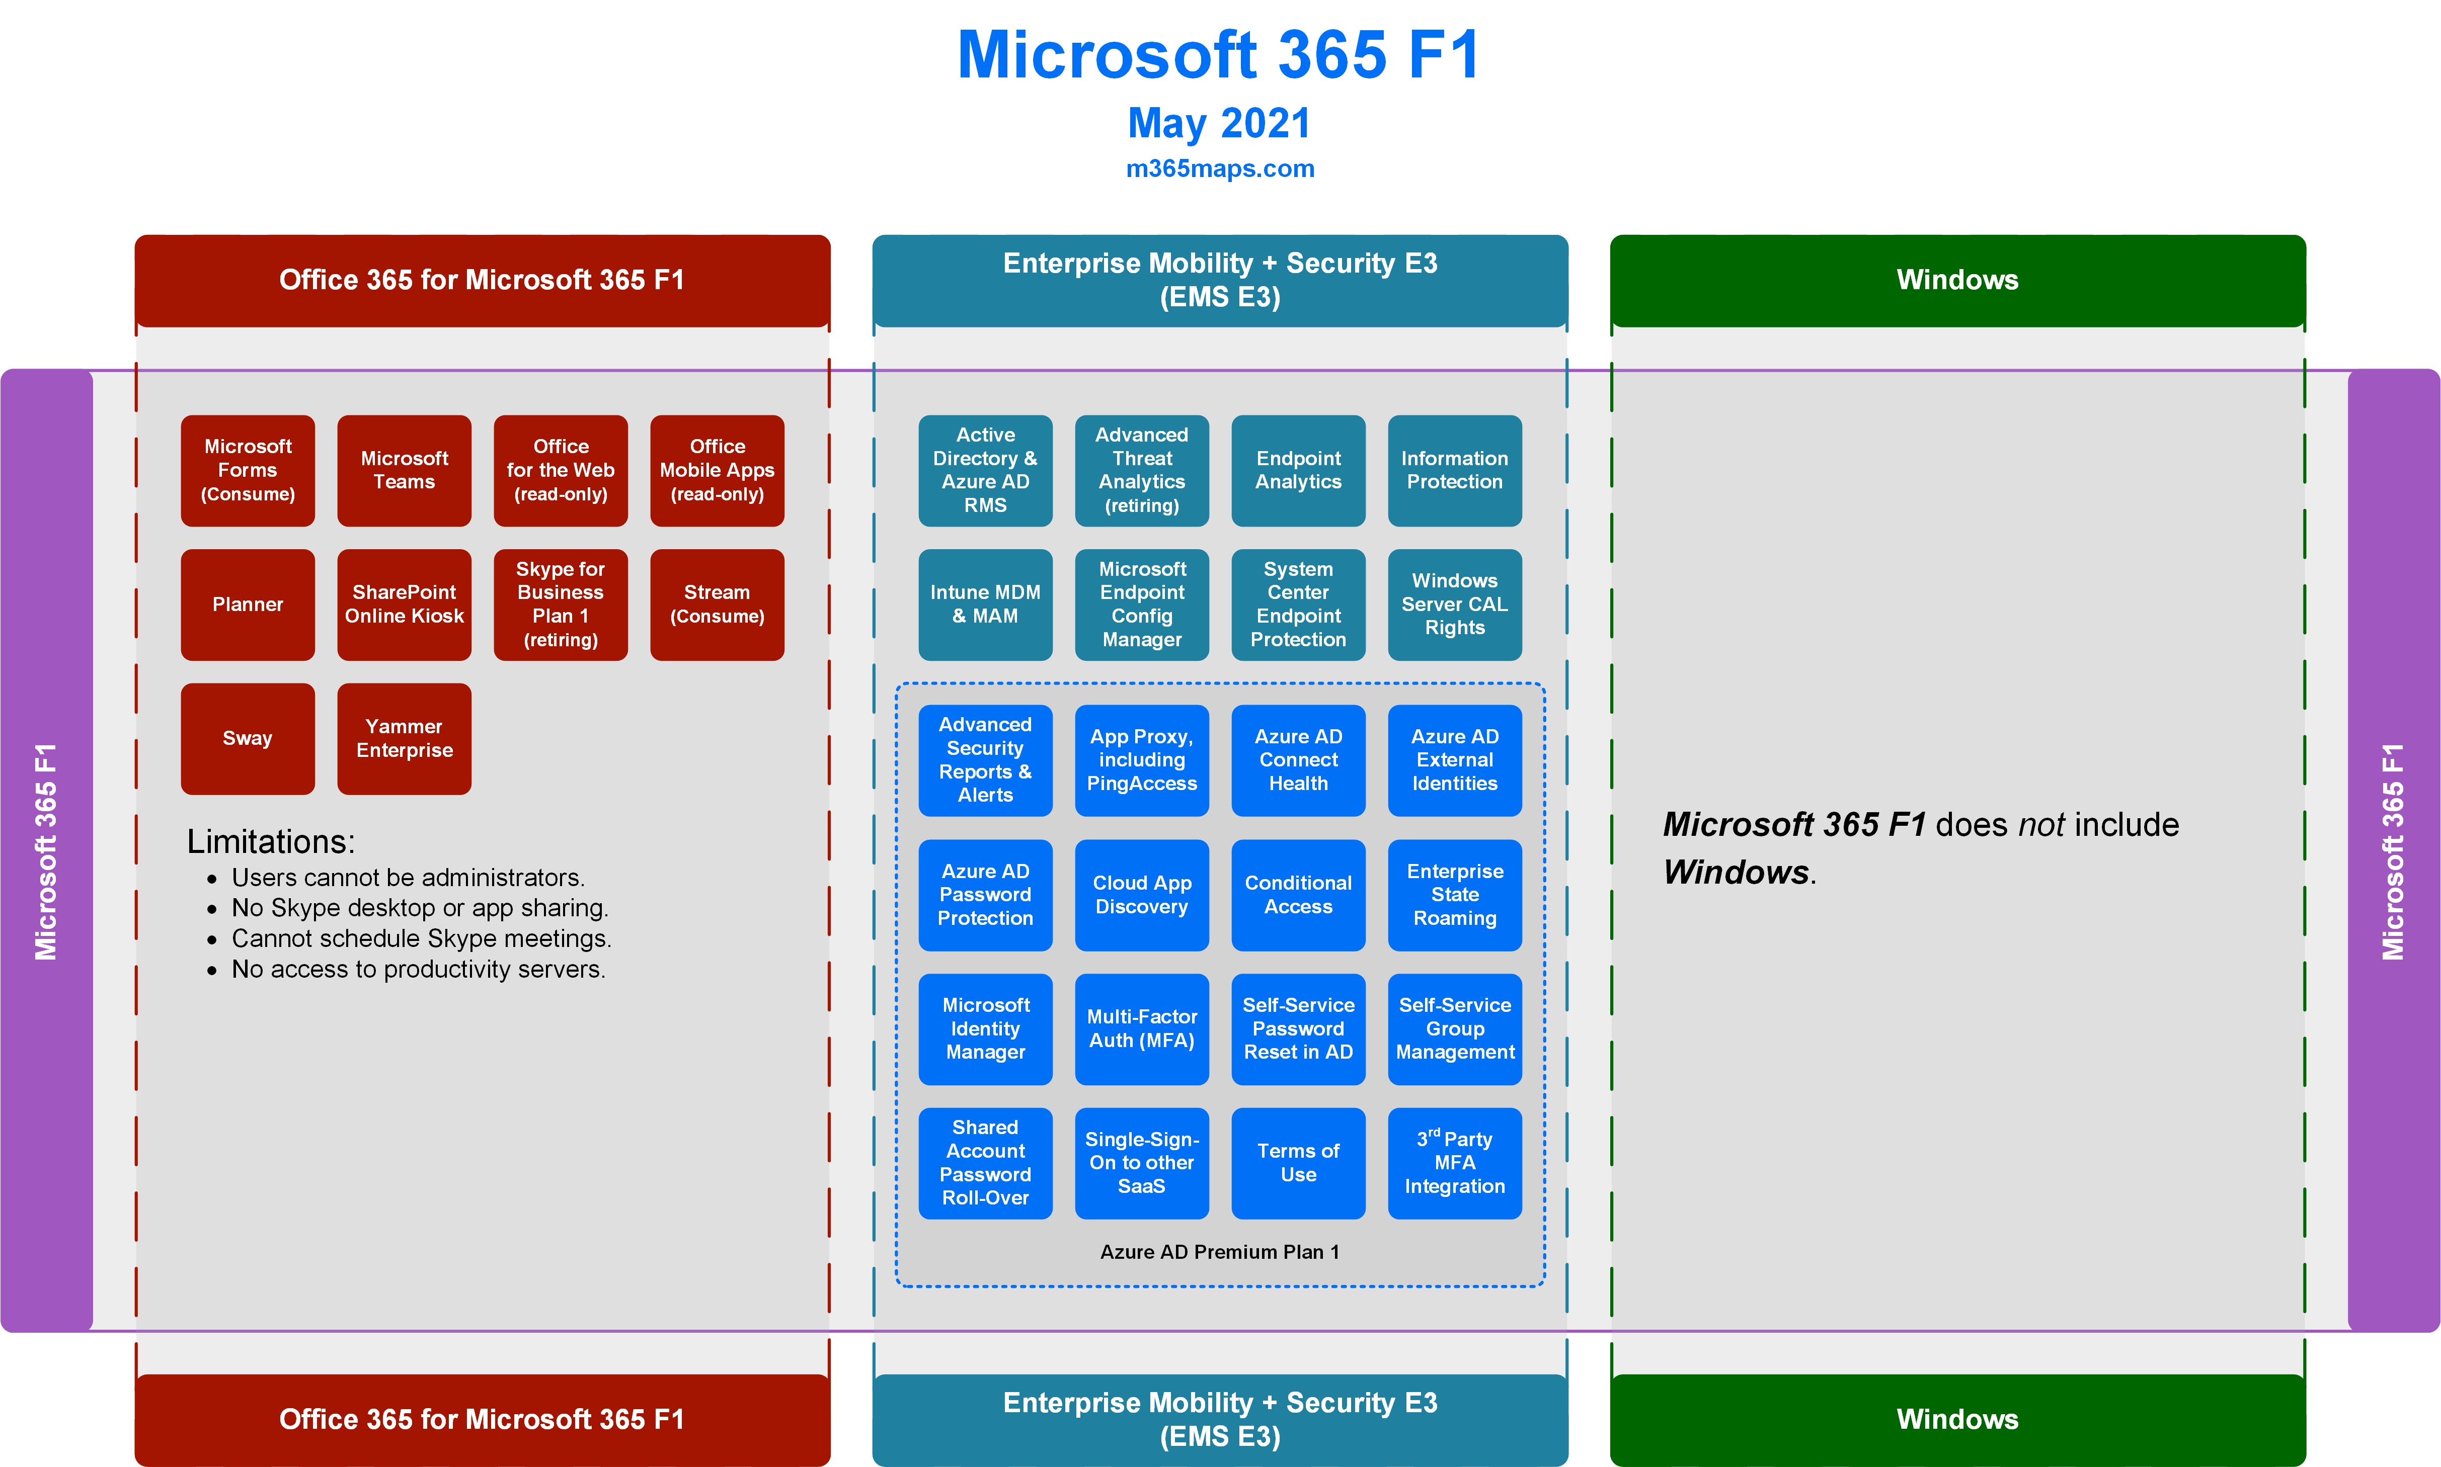

Slide 5
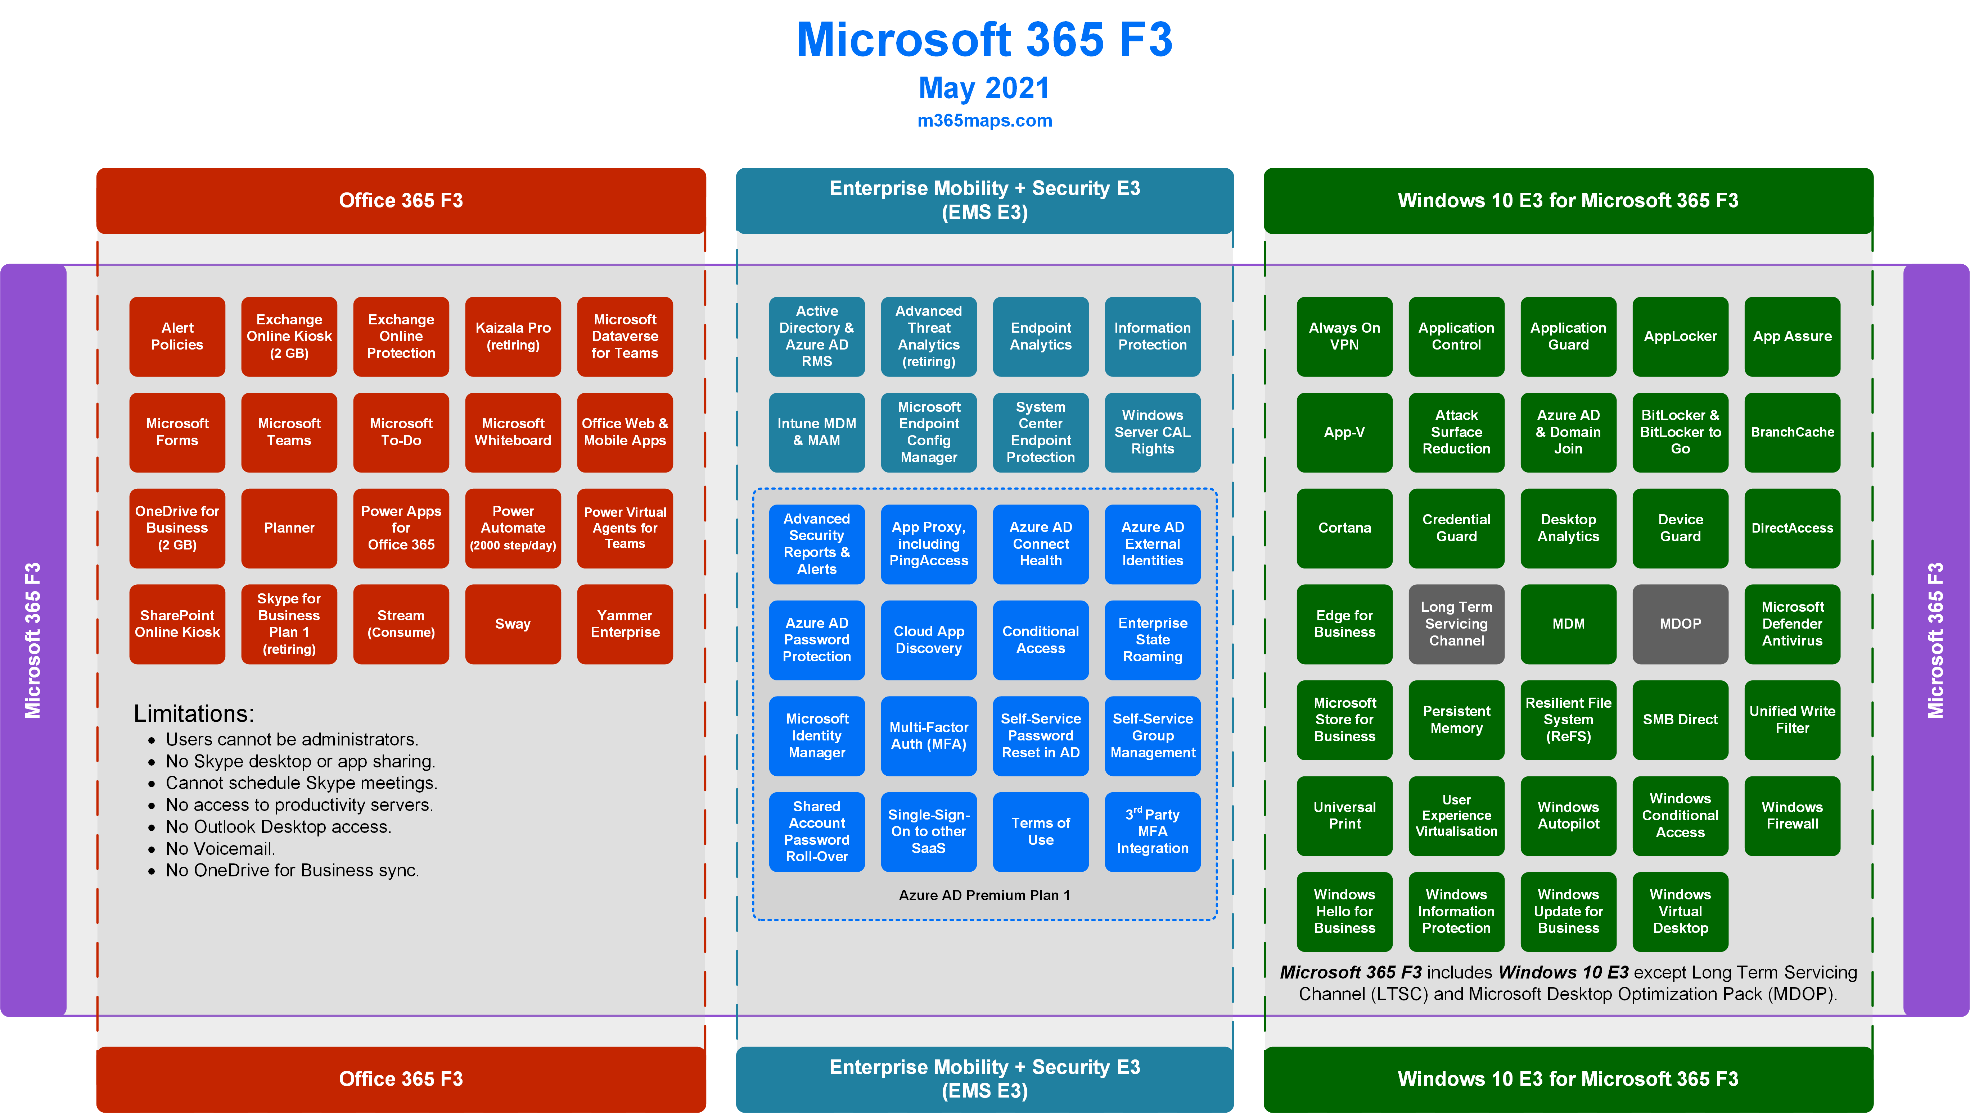

Slide 6
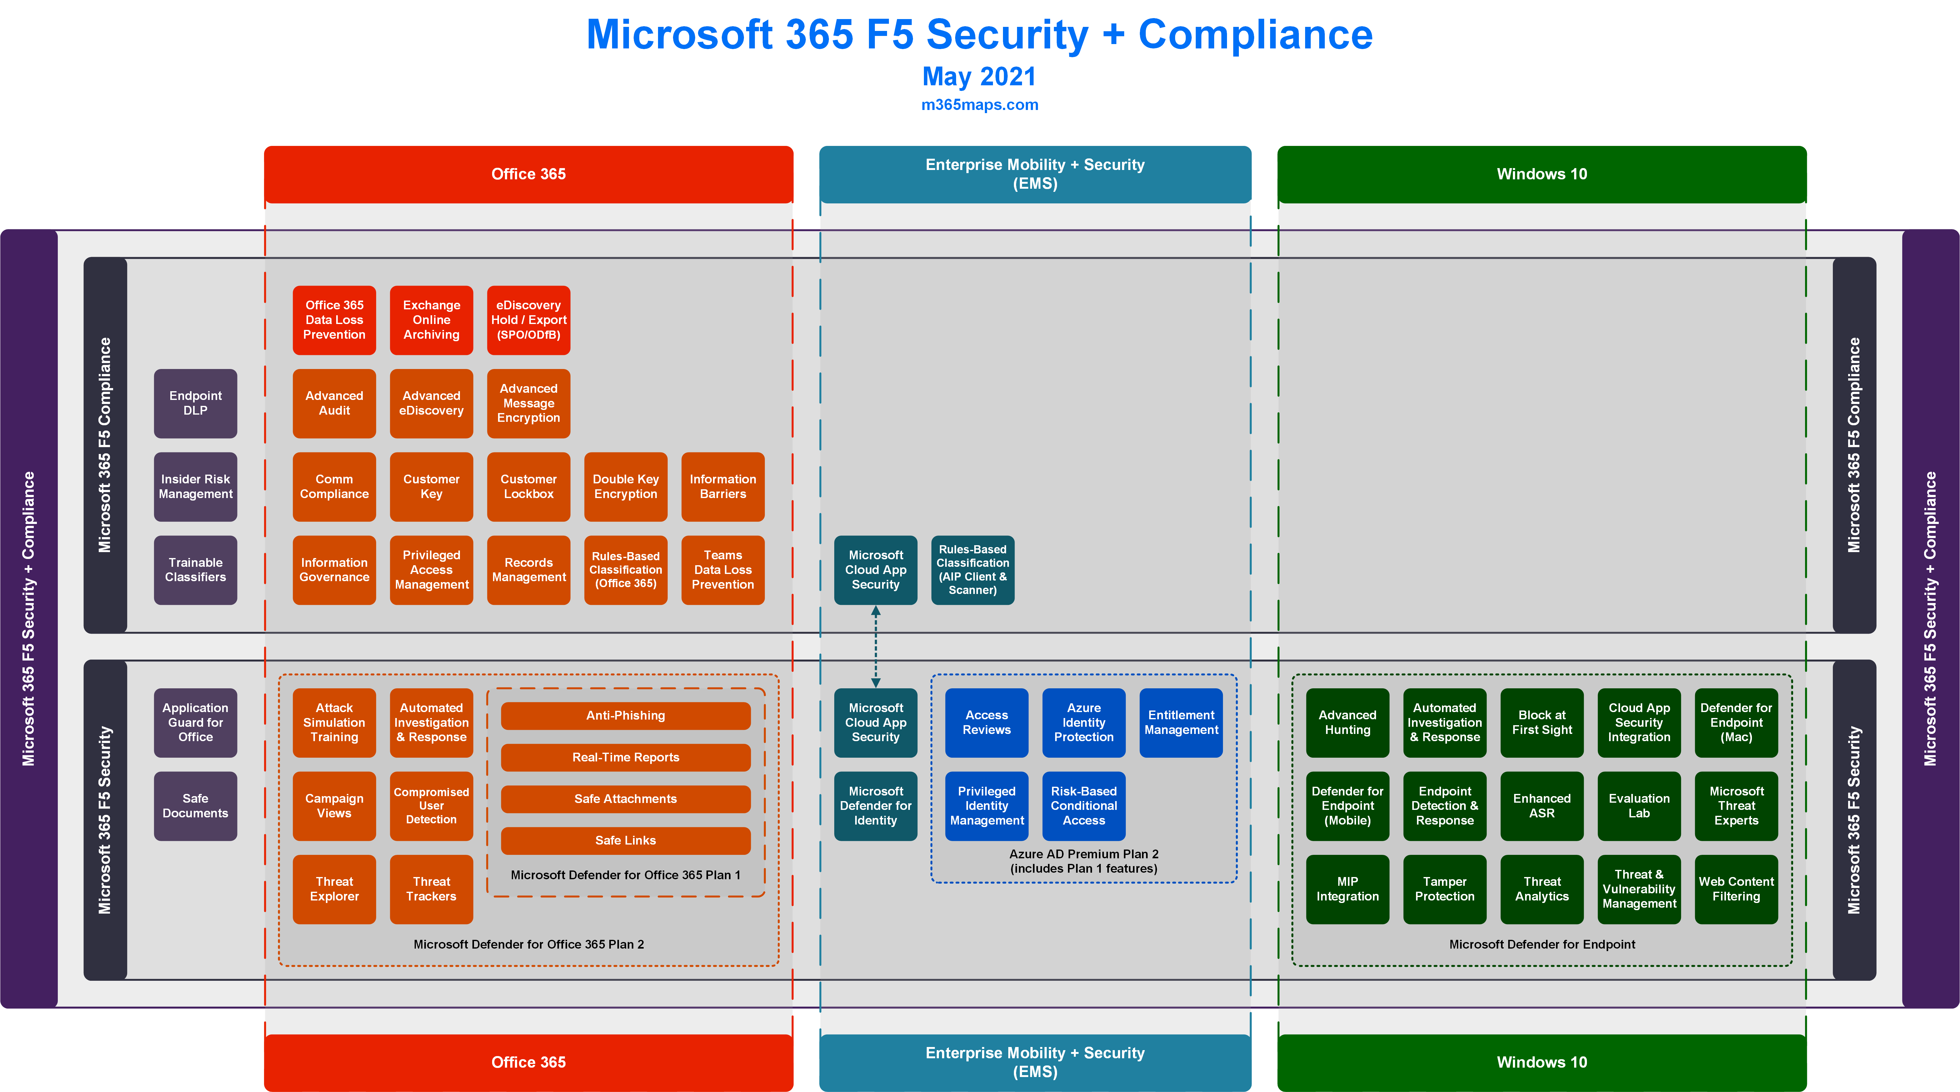

Slide 7
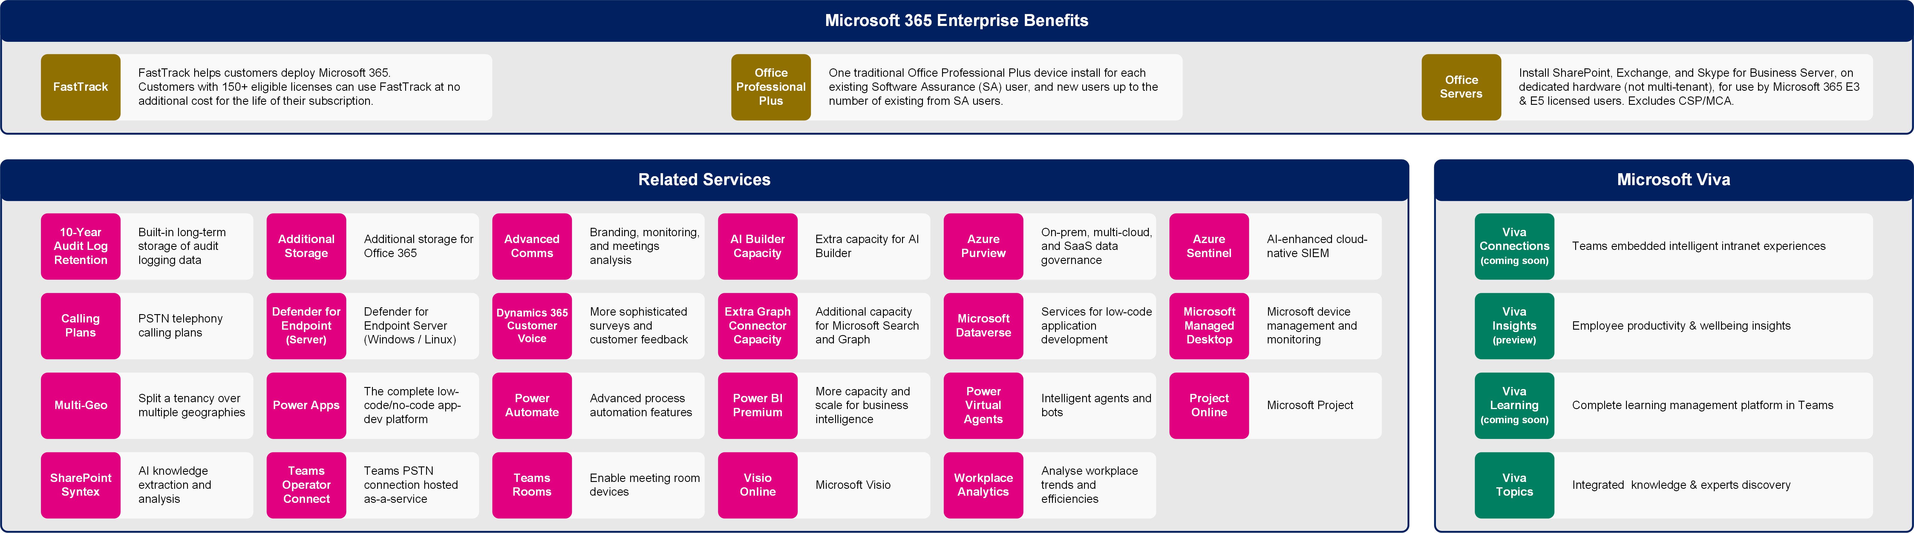
Microsoft 365 Enterprise Benefits, Microsoft Viva, and Related Services
Latest diagrams available here: https://m365maps.com

Slide 8
Microsoft 365 Business
Licensing overview
May 2021
Latest diagrams available here:
https://m365maps.com

Slide 9
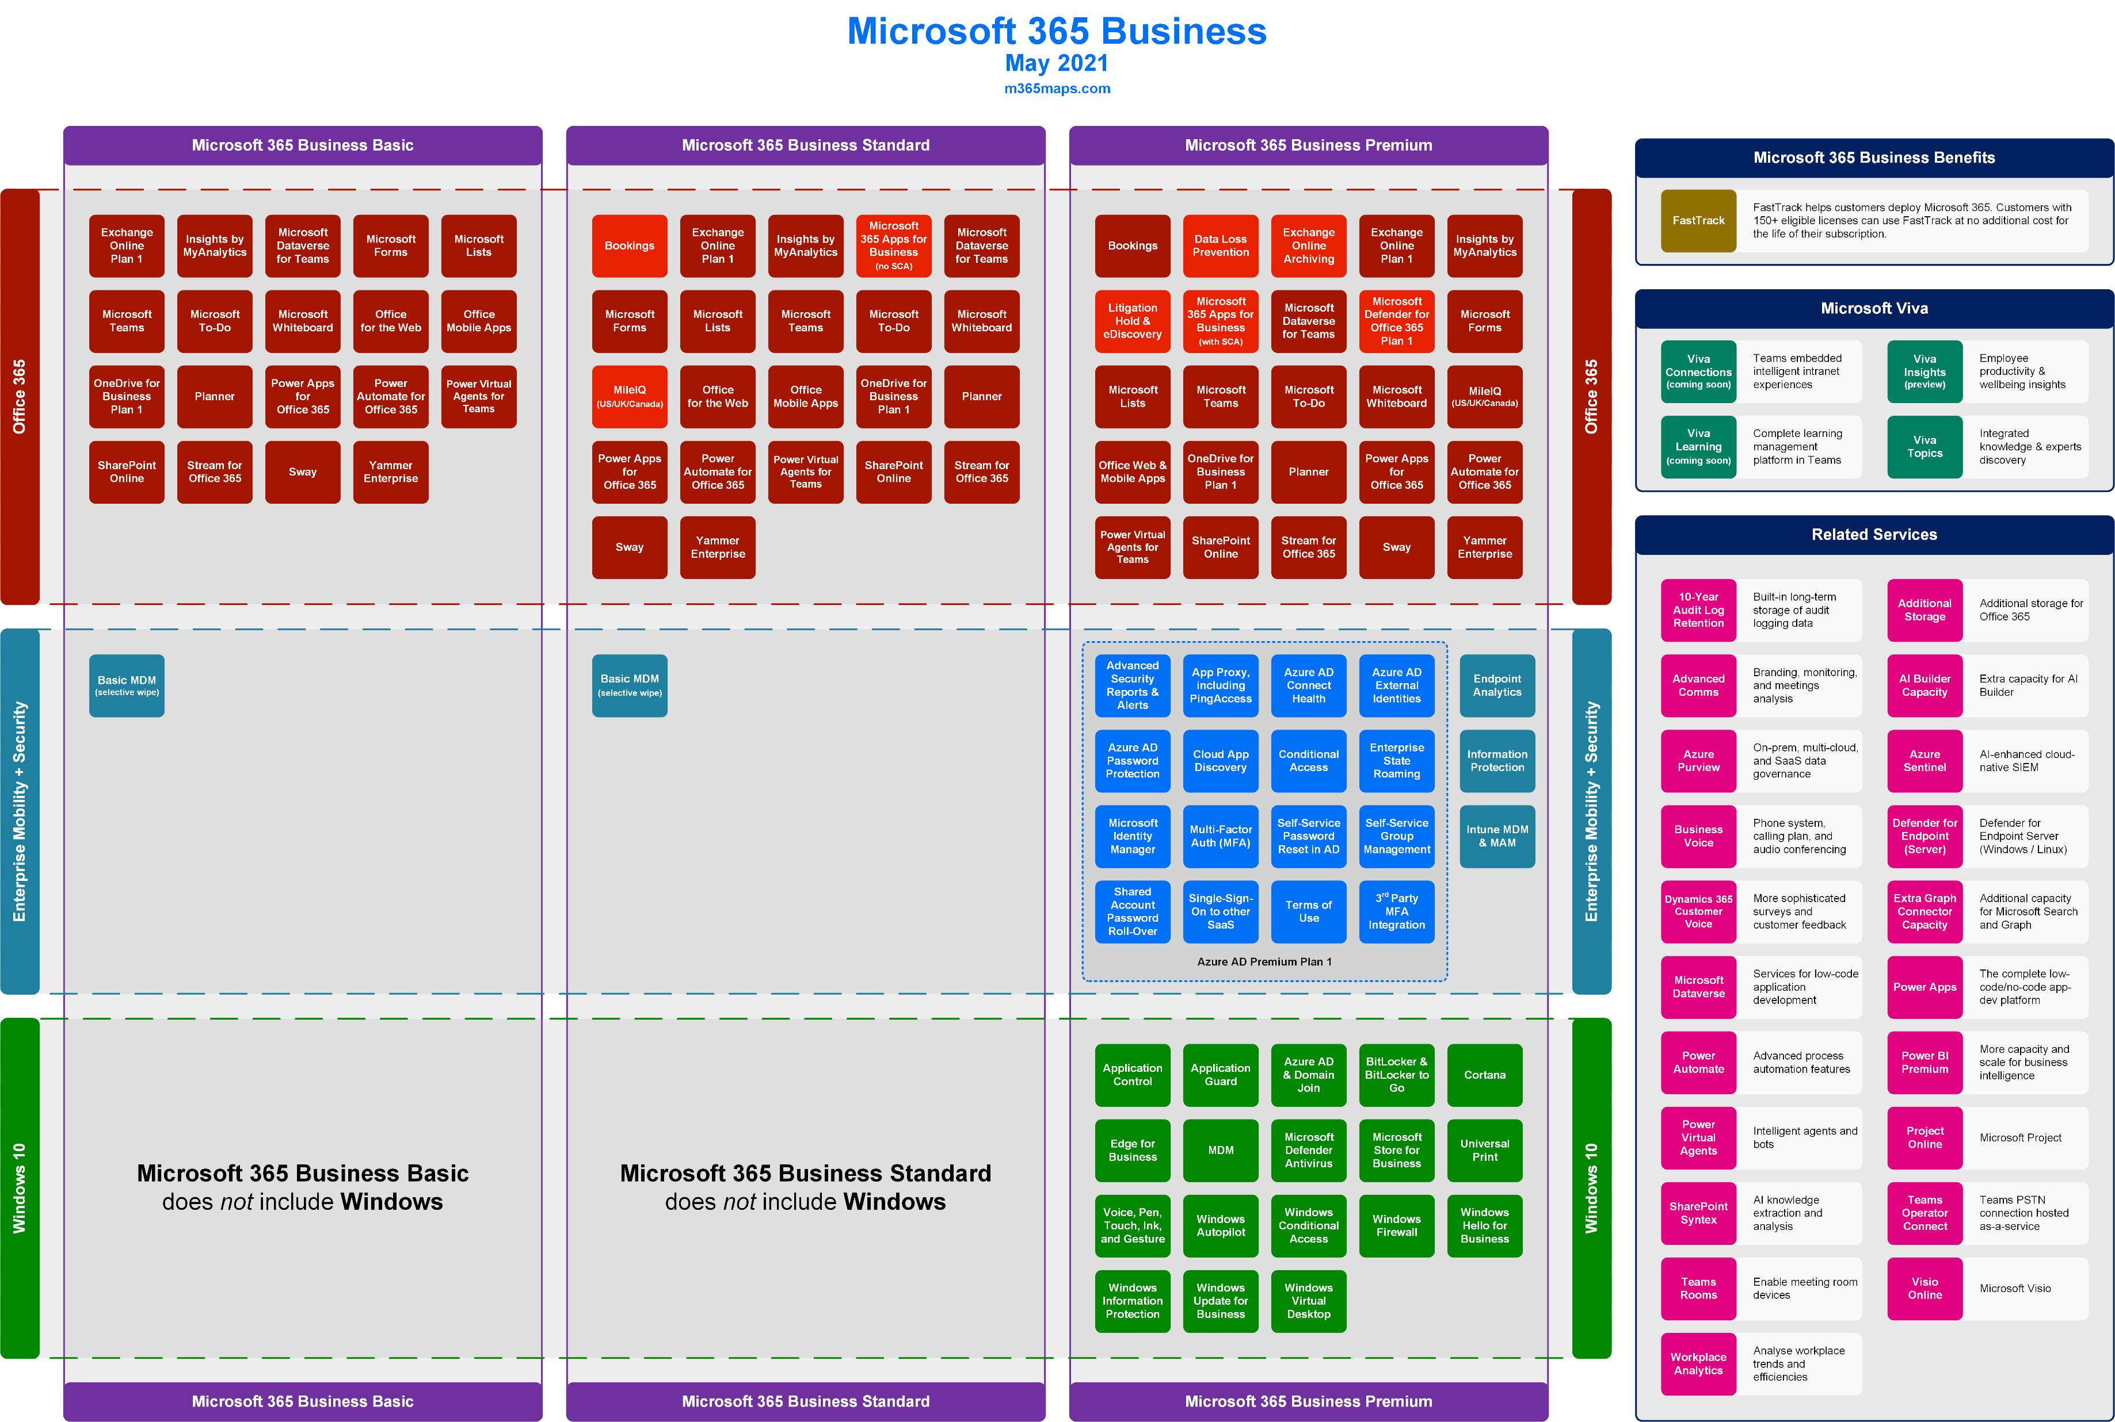

Slide 10
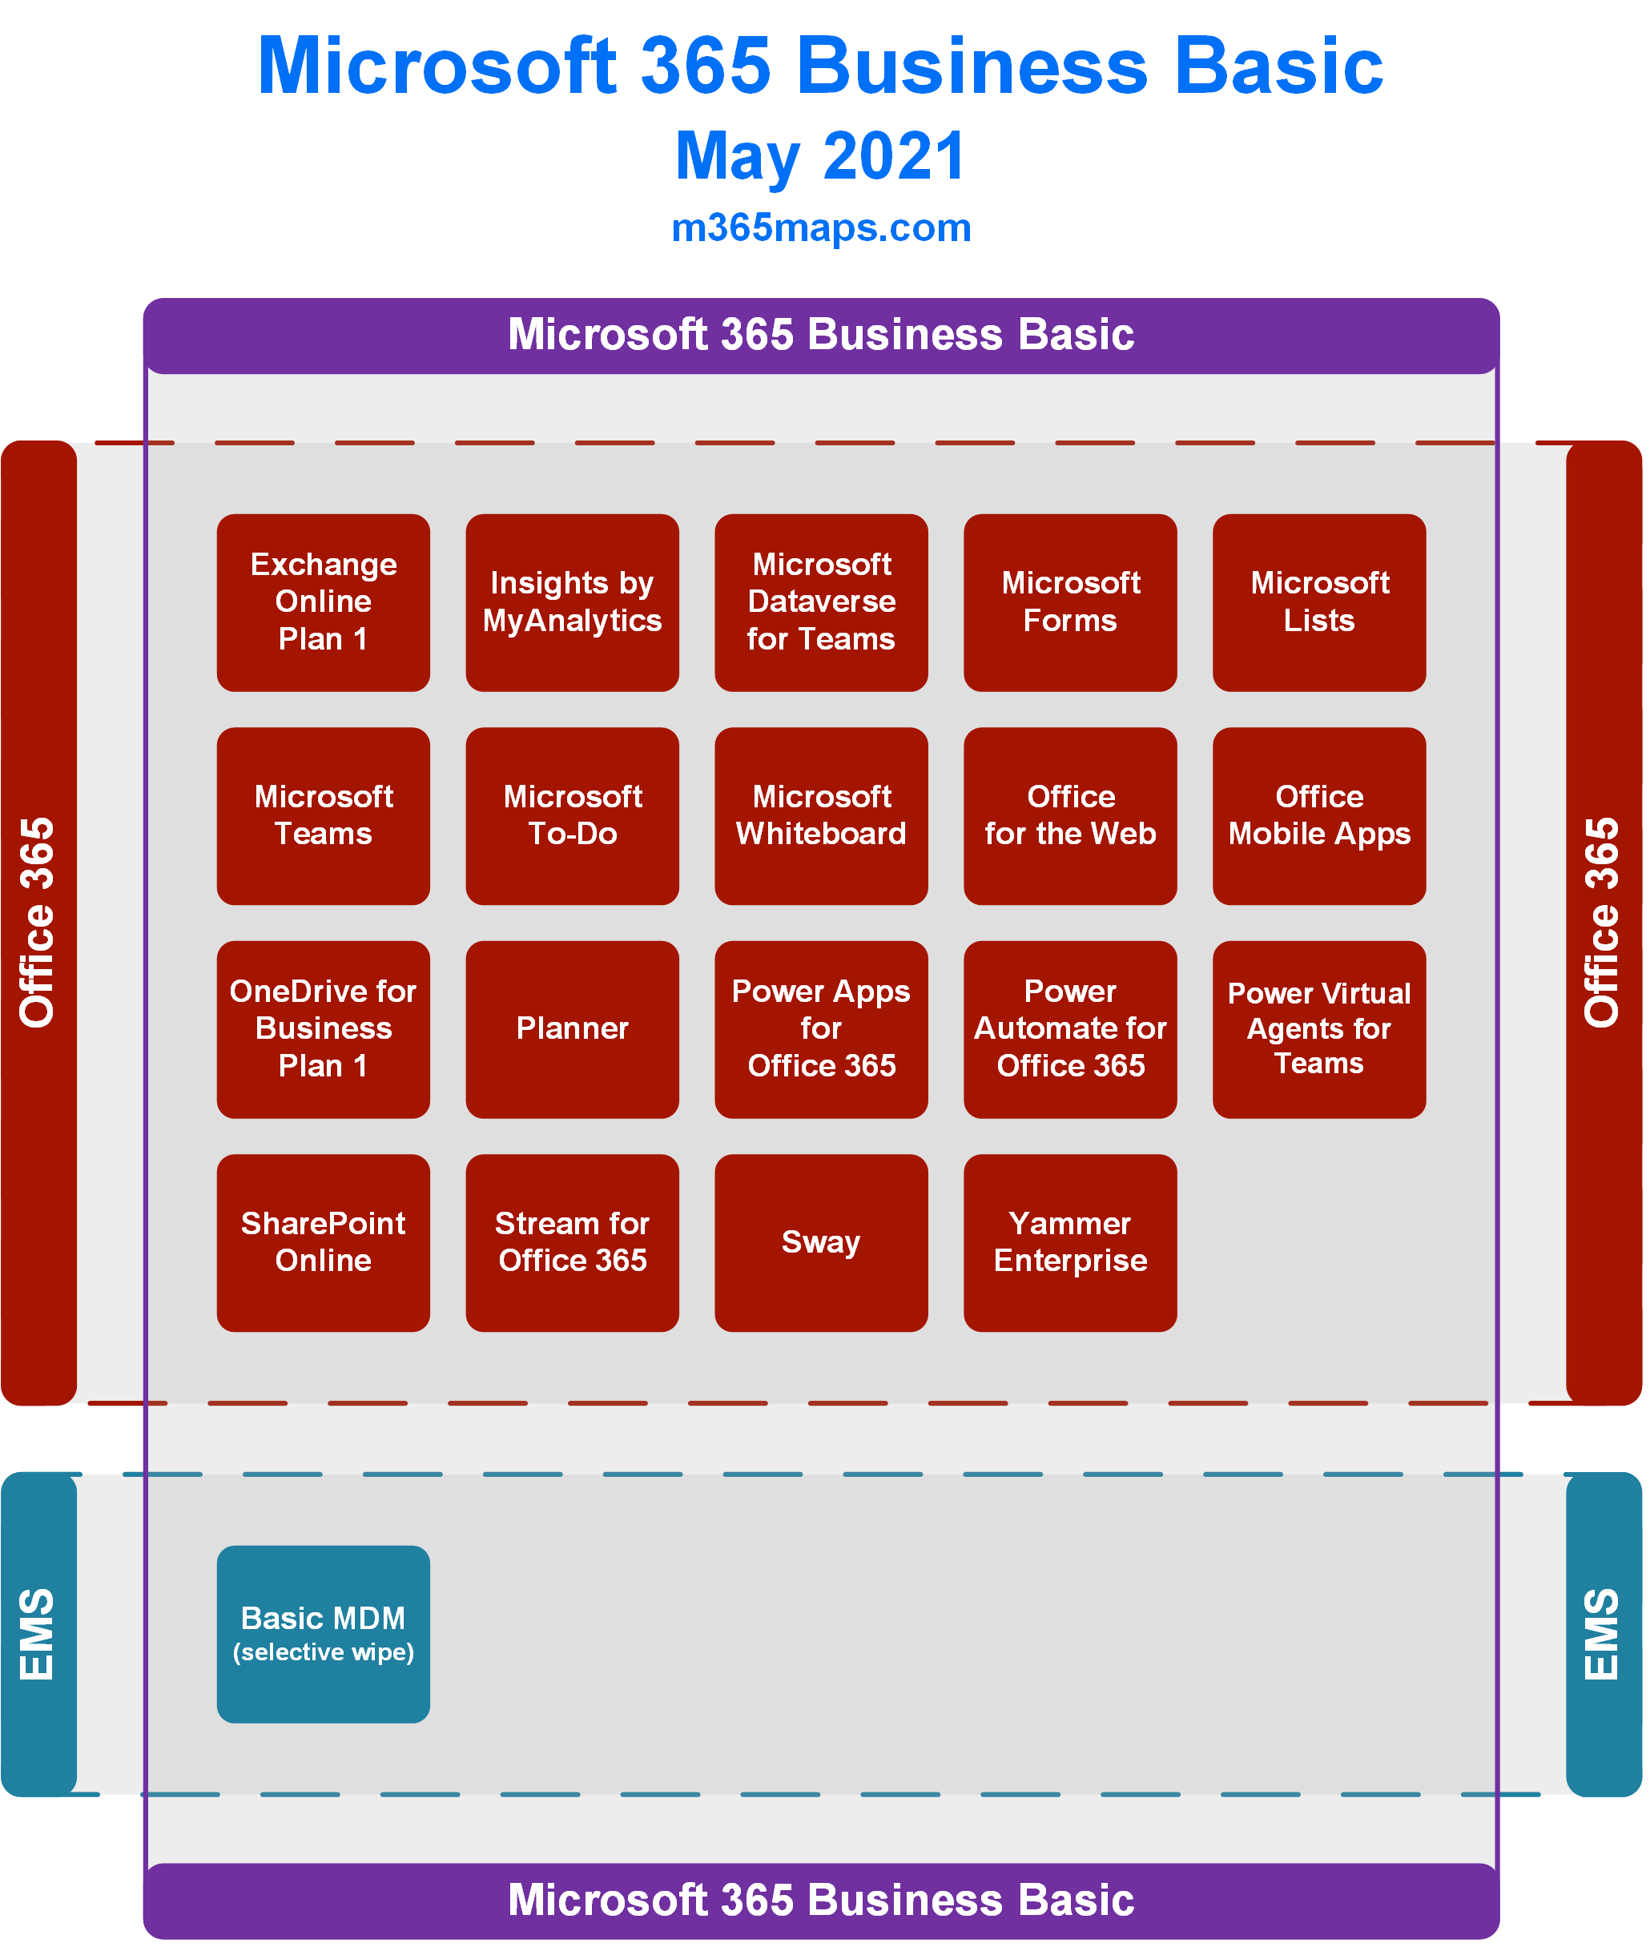

Slide 11
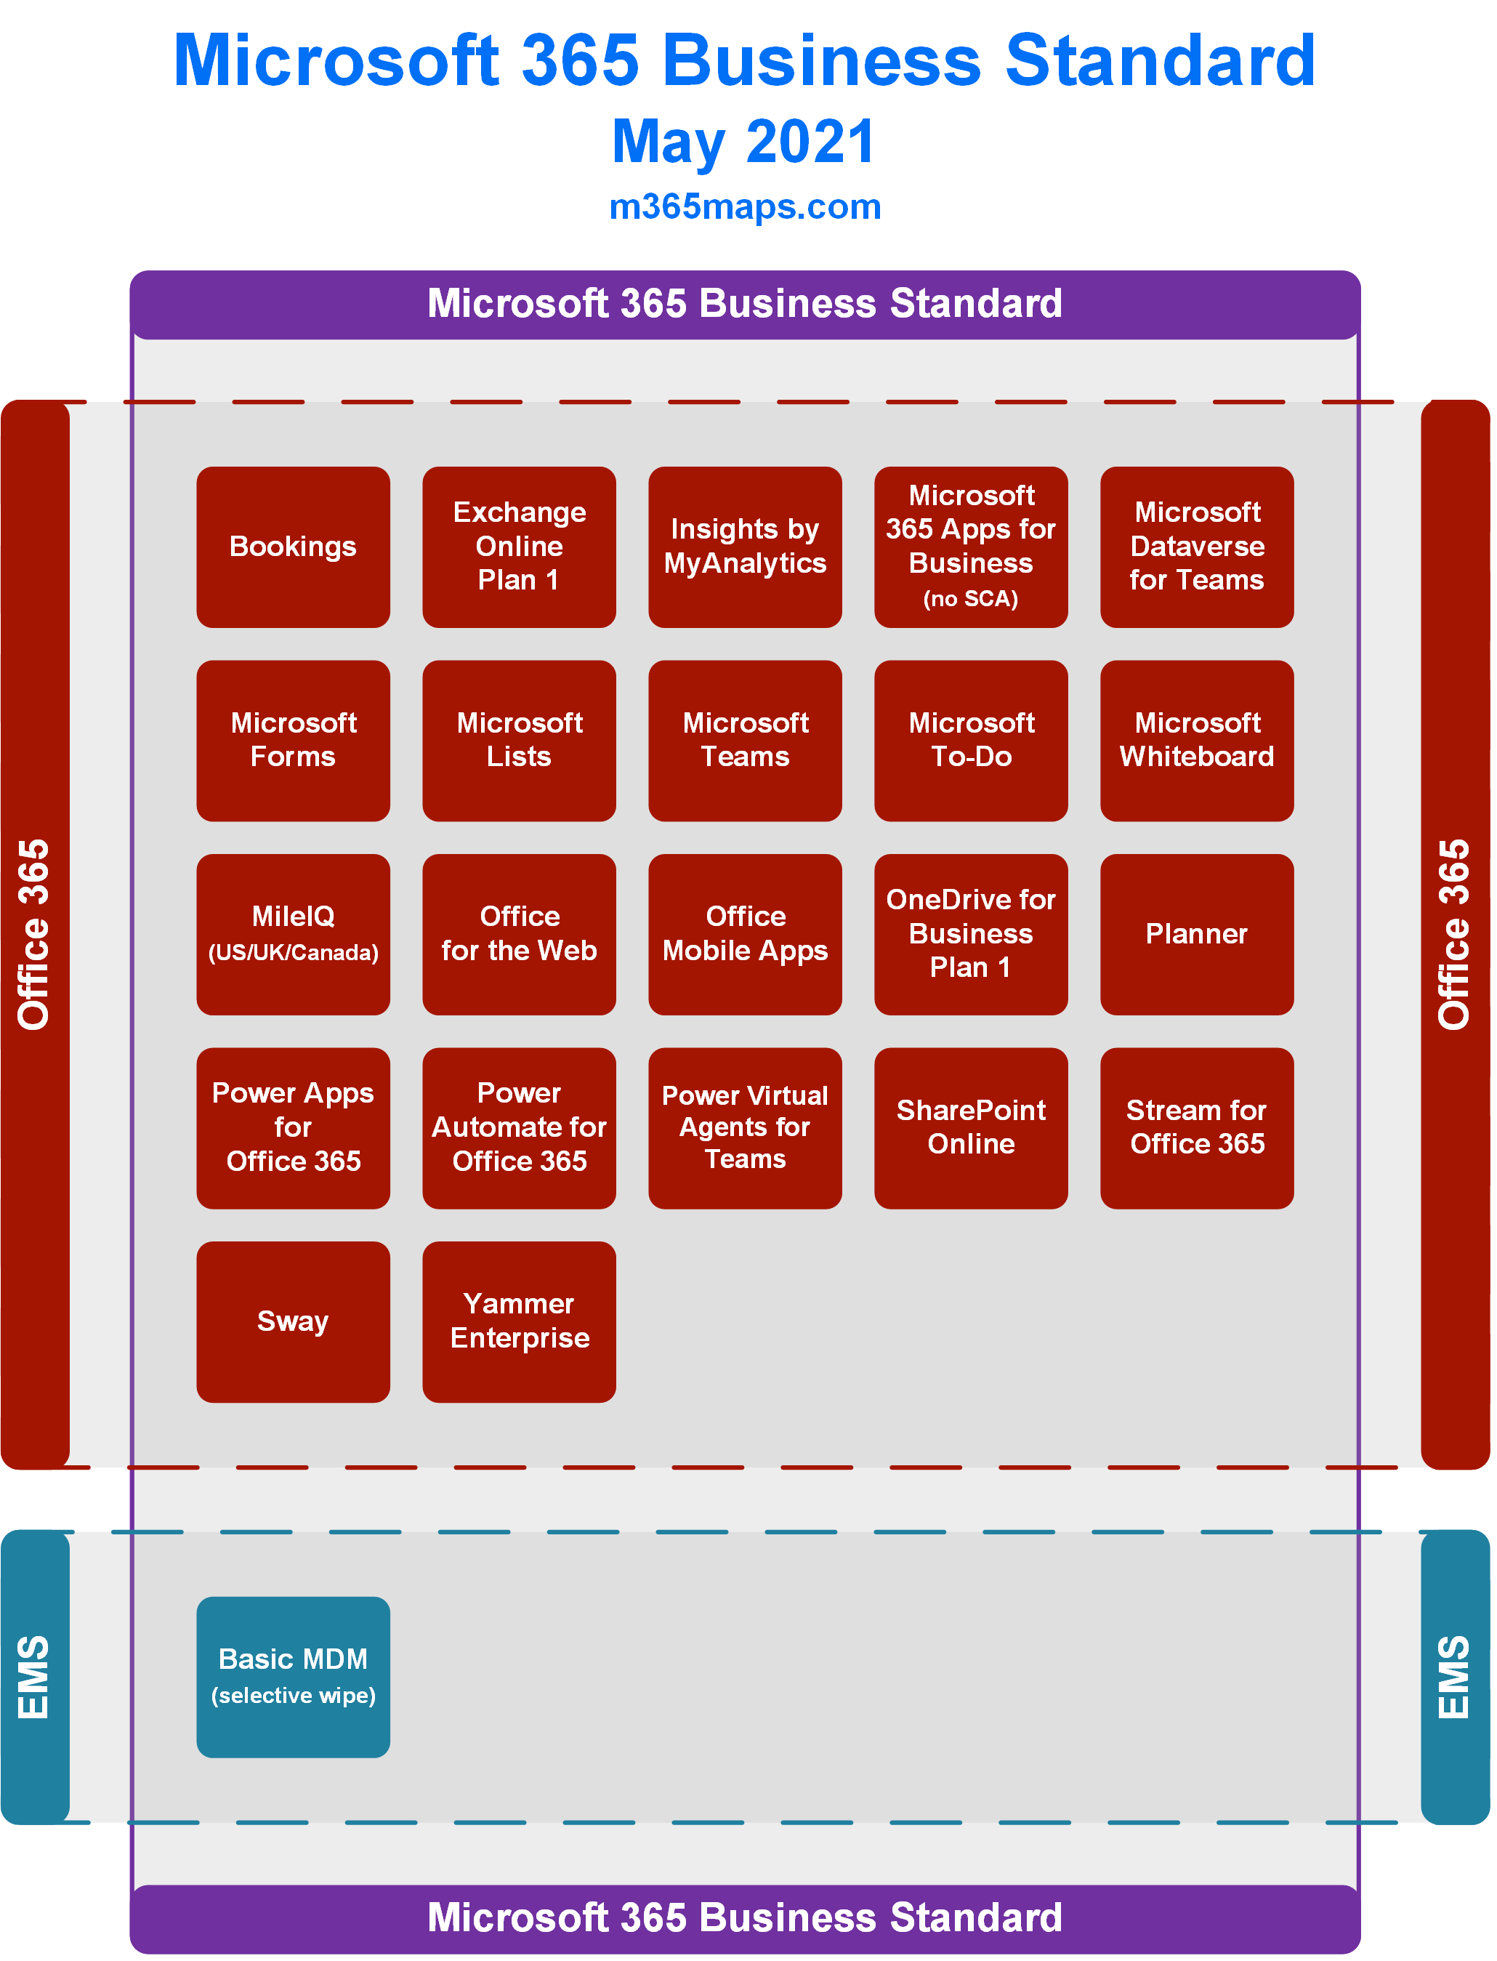

Slide 12
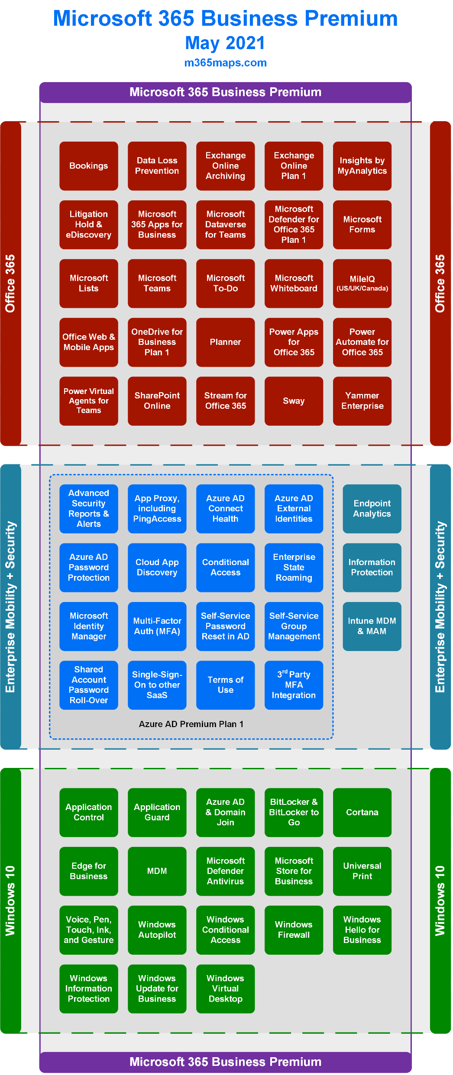

Slide 13
Website https://m365maps.com GitHub https://github.com/AaronDinnage/Licensing Updates on Twitter and LinkedIn https://twitter.com/AaronDinnage https://www.linkedin.com/in/aarondinnage/

